Slide 1
Stem cells
Unlocking potential for regenerative medicine

Slide 2
Stem cells
“Stem cells are special human cells that can develop into many different types of cells, from muscle cells to brain cells.”

Slide 3
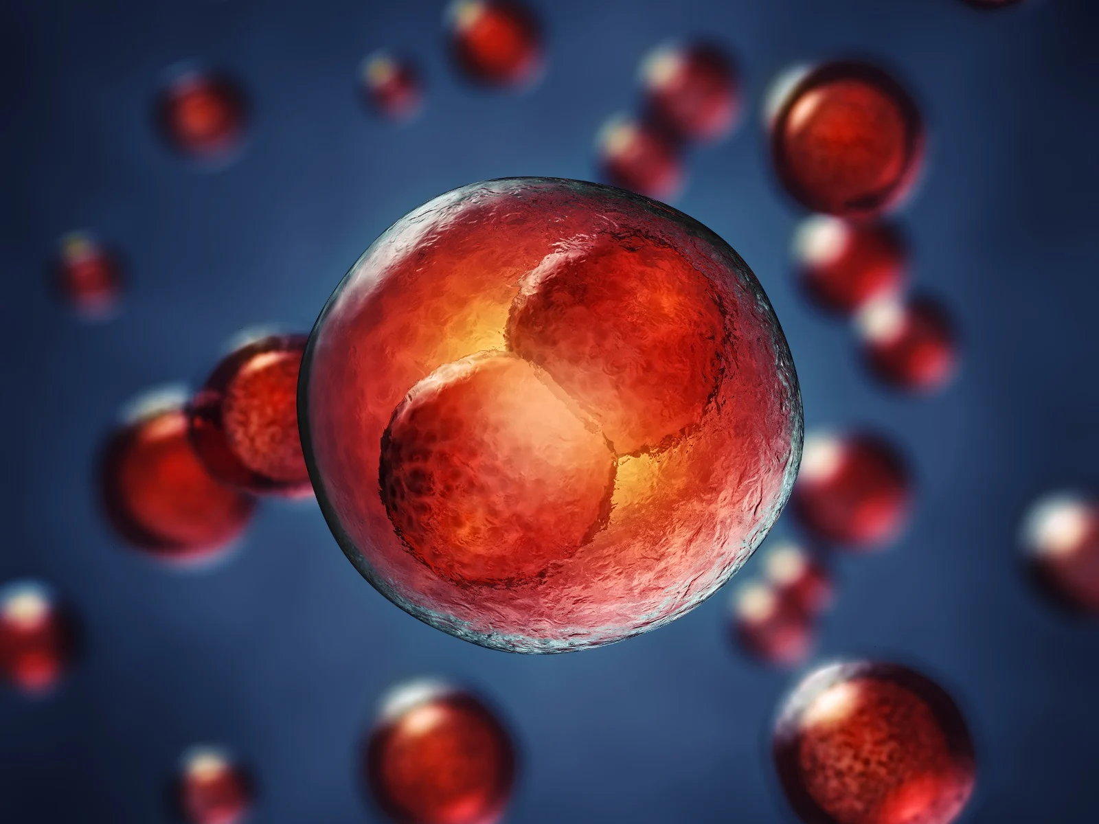
Stem cells:
The body’s master cells.

Slide 4
What are stem cells?
Stem cells are undifferentiated biological cells that can differentiate into specialized cells.
These are the body's raw materials, cells from which all other cells with specialized functions are generated.
Under the right conditions in the body or a laboratory, stem cells divide to form more cells called daughter cells.

Slide 5
These daughter cells become either new stem cells or specialized cells (differentiation) with a more specific function, such as blood cells, brain cells, heart muscle cells or bone cells.
No other cell in the body has the natural ability to generate new cell types.

Slide 6
Functions of stem cells
Stem cells provide new cells for the body as it grows and replace specialized cells that are damaged or lost.
They have two unique properties that enable them to do this:
They can divide over and over again to produce new cells.
As they divide, they can change into the other types of cell that make up the body.

Slide 7
Stem cells also have the ability to repair damaged cells.
These cells have strong healing power.
They can evolve into any type of cell.

Slide 8
Types of stem cells
Stem cells are of the following different types:
Embryonic Stem Cells
Adult Stem Cells
Induced Pluripotent Stem Cells
Mesenchymal stem cells

Slide 9
Researchers categorize stem cells, according to their potential to differentiate into other types of cells.
Embryonic stem cells are the most potent, as their job is to become every type of cell in the body.

Slide 10
Embryonic stem cells
From the very earliest stage of pregnancy, after the sperm fertilizes the egg, an embryo forms.
Around 3–5 days after a sperm fertilizes an egg, the embryo takes the form of a blastocyst or ball of cells.
The blastocyst contains stem cells and will later implant in the womb.
Embryonic stem cells come from a blastocyst that is 4–5 days old.

Slide 11
When scientists take stem cells from embryos, these are usually extra embryos that result from in vitro fertilization (IVF).
In IVF clinics, the doctors fertilize several eggs in a test tube, to ensure that at least one survives.
They will then implant a limited number of eggs to start a pregnancy.

Slide 12
When a sperm fertilizes an egg, these cells combine to form a single cell called a zygote.
This single-celled zygote then starts to divide, forming 2, 4, 8, 16 cells, and so on. Now it is an embryo.
Soon, and before the embryo implants in the uterus, this mass of around 150–200 cells is the blastocyst.
The blastocyst consists of two parts:
an outer cell mass that becomes part of the placenta
an inner cell mass that will develop into the human body

Slide 13
The inner cell mass is where embryonic stem cells are found.
Scientists call these totipotent cells.
The term totipotent refer to the fact that they have total potential to develop into any cell in the body.
With the right stimulation, the cells can become blood cells, skin cells, and all the other cell types that a body needs.

Slide 14
In early pregnancy, the blastocyst stage continues for about 5 days before the embryo implants in the uterus, or womb.
At this stage, stem cells begin to differentiate.
Embryonic stem cells can differentiate into more cell types than adult stem cells.

Slide 15
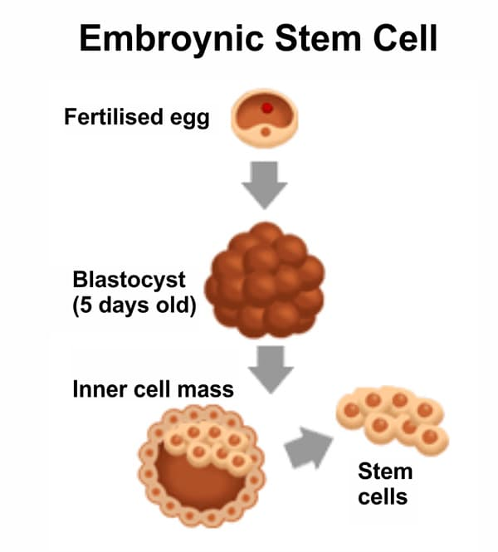
The fertilized egg begins to divide immediately.
All the cells in the young embryo are totipotent cells.
These cells form a hollow structure within a few days.
Cells in one region group together to form the inner cell mass.
This contains pluripotent cells that make up the developing foetus.

Slide 16
The embryonic stem cells can be further classified into:
Totipotent stem cells
Pluripotent stem cells
Multipotent stem cells
Oligopotent stem cells
Unipotent stem cells

Slide 17
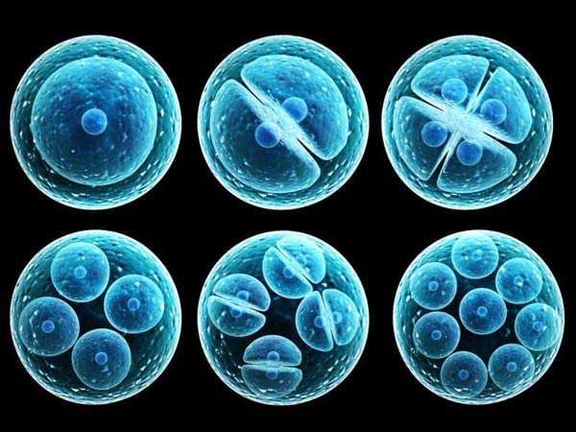
Totipotent stem cells [Omnipotent cells]
These stem cells can differentiate into all possible cell types.
The first few cells that appear as the zygote starts to divide are totipotent.
Can develop into a fully functional living organism.
Eg: Fertilized egg

Slide 18
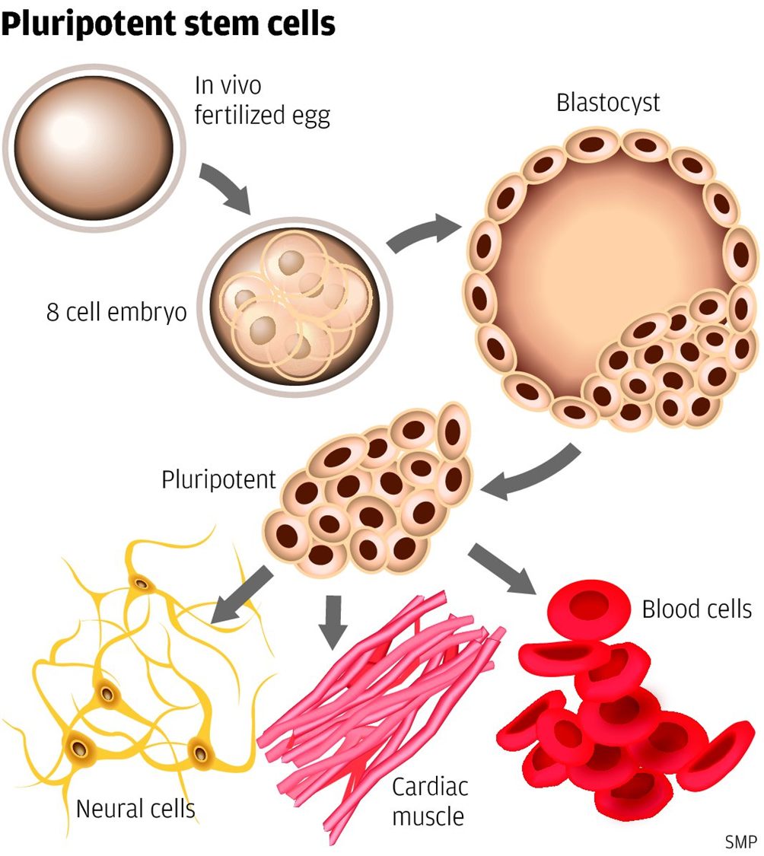
Pluripotent stem cells
These cells can differentiate into almost any cell type.
Cells from the early embryo are pluripotent.

Slide 19
Multipotent stem cells
These differentiate into a closely related cell type.
Eg:the hematopoietic stem cells differentiate into red blood cells and white blood cells.

Slide 20
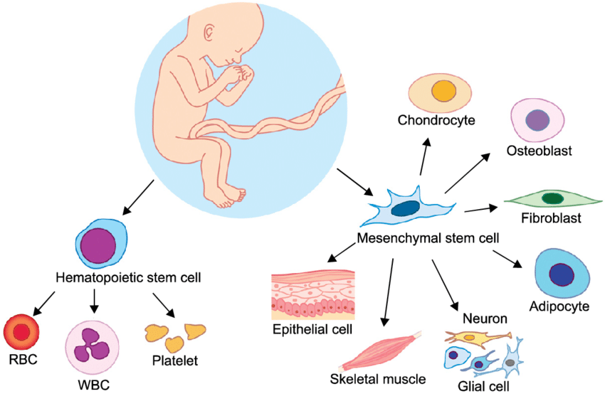

Slide 21
Oligopotent stem cells
Adult lymphoid or myeloid cells are oligopotent.
They can differentiate into a few different types of cells.

Slide 22
Unipotent stem cells
They can produce cells only of their own type.
Since they have the ability to renew themselves, they are known as unipotent stem cells.
E.g., Muscle stem cells.

Slide 23
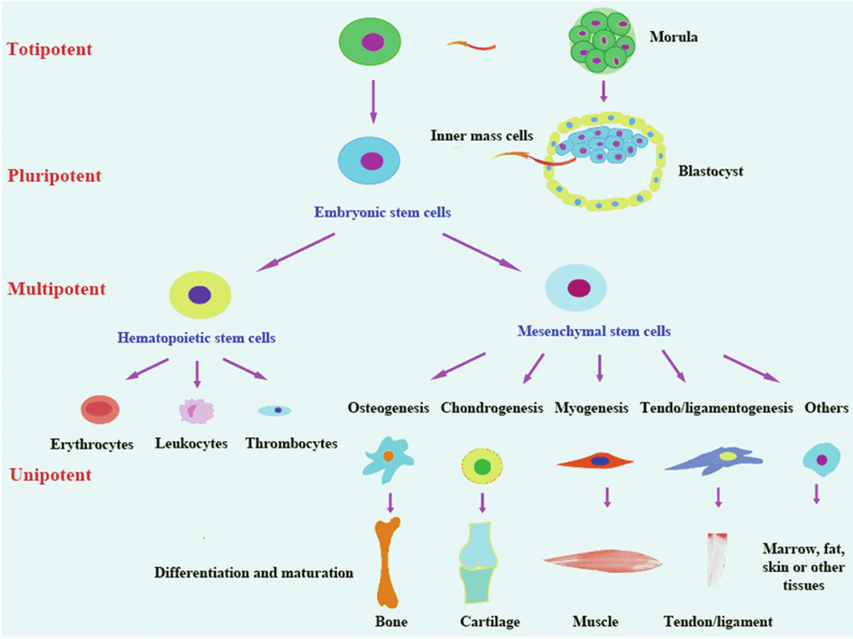

Slide 24
Adult stem cells
A person’s body contains stem cells throughout their life.
The body can use these stem cells whenever it needs them.
Also called tissue-specific or somatic stem cells, adult stem cells exist throughout the body from the time an embryo develops.
The cells are in a non-specific state, but they are more specialized than embryonic stem cells.
They remain in this state until the body needs them for a specific purpose, say, as skin or muscle cells.

Slide 25
Day-to-day living means the body is constantly renewing its tissues.
In some parts of the body, such as the gut and bone marrow, stem cells regularly divide to produce new body tissues for maintenance and repair.
Stem cells are present inside different types of tissue. Scientists have found stem cells in tissues, including:
the brain
bone marrow
blood and blood vessels
skeletal muscles
skin
the liver

Slide 26
However, stem cells can be difficult to find.
They can stay non-dividing and non-specific for years until the body summons them to repair or grow new tissue.
Adult stem cells can divide or self-renew indefinitely.
This means they can generate various cell types from the originating organ or even regenerate the original organ, entirely.

Slide 27
This division and regeneration are how a skin wound heals, or how an organ such as the liver,for example, can repair itself after damage.
In the past, scientists believed adult stem cells could only differentiate based on their tissue of origin.
However, some evidence now suggests that they can differentiate to become other cell types, as well.

Slide 28
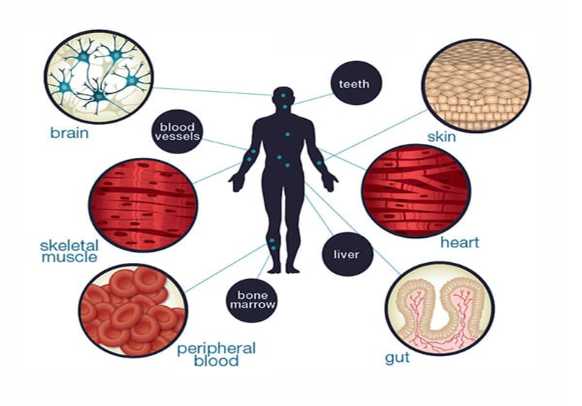
These stem cells are obtained from developed organs and tissues.
They can repair and replace the damaged tissues in the region where they are located. For eg, hematopoietic stem cells are found in the bone marrow.
These stem cells are used in bone marrow transplants to treat specific types of cancers.

Slide 29
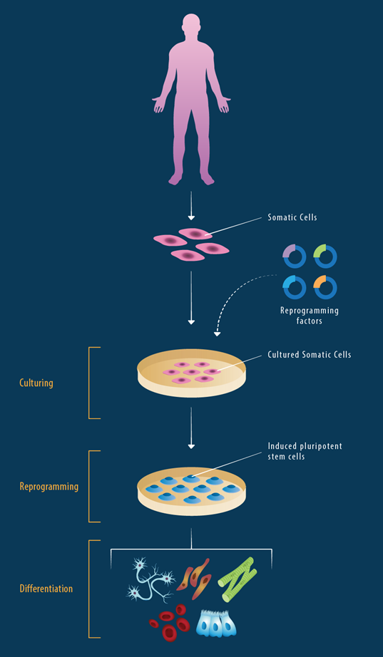
Induced pluripotent stem cells[ IPS]
Scientists create these in a lab, using skin cells and other tissue-specific cells.
These cells behave in a similar way to embryonic stem cells, so they could be useful for developing a range of therapies.
However, more research and development is necessary.

Slide 30
To grow stem cells, scientists first extract samples from adult tissue or an embryo.
They then place these cells in a controlled culture where they will divide and reproduce but not specialize further.
Stem cells that are dividing and reproducing in a controlled culture are called a stem-cell line.

Slide 31
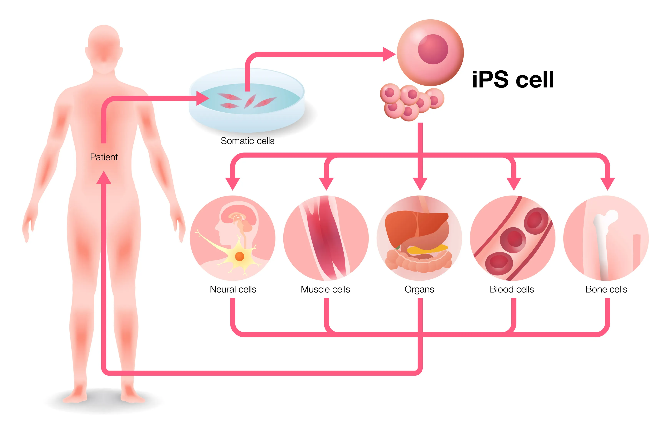

Slide 32
Researchers manage and share stem-cell lines for different purposes.
They can stimulate the stem cells to specialize in a particular way. This process is known as directed differentiation.
Until now, it has been easier to grow large numbers of embryonic stem cells than adult stem cells.
However, scientists are making progress with both cell types.

Slide 33
These cells have been tested and arranged by converting tissue-specific cells into embryonic cells in the lab.
These cells are accepted as an important tool to learn about the normal development, onset and progression of the disease and are also helpful in testing various drugs.
These stem cells share the same characteristics as embryonic cells do.
They also have the potential to give rise to all the different types of cells in the human body.

Slide 34
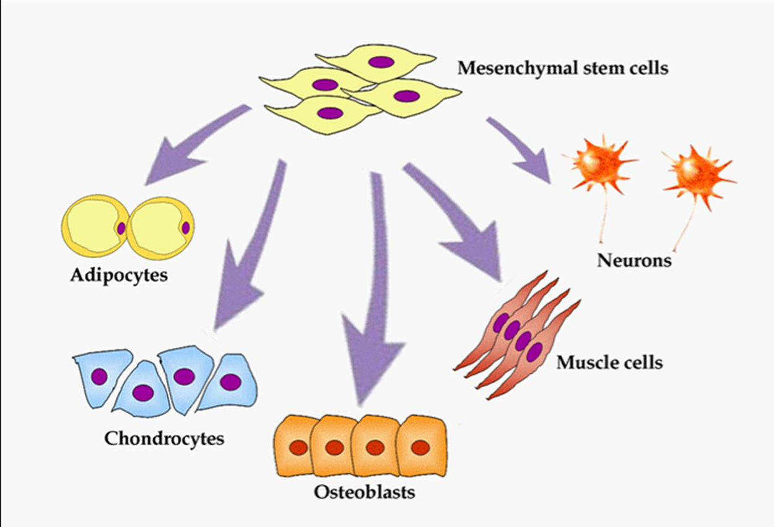
Mesenchymal stem cells
These cells are mainly formed from the connective tissues surrounding other tissues and organs, known as the stroma.
These mesenchymal stem cells are accurately called stromal cells.
The first mesenchymal stem cells were found in the bone marrow that is capable of developing bones, fat cells, and cartilage.

Slide 35
There are different mesenchymal stem cells that are used to treat various diseases as they have been developed from different tissues of the human body.
The characteristics of mesenchymal stem cells depend on the organ from where they originate.

Slide 36
What is stem cell therapy?
Stem-cell therapy is the use of stem cells to cure or prevent a disease or condition.
The damaged cells are repaired by the generated stem cells, which can also hasten the healing process in the injured tissue.
These cells are essential for the regeneration and transplanting of tissue.

Slide 37
uses:
Stem cells themselves do not serve any single purpose but are important for several reasons.
First, with the right stimulation, many stem cells can take on the role of any type of cell, and they can regenerate damaged tissue, under the right conditions.
This potential could save lives or repair wounds and tissue damage in people after an illness or injury.
Scientists see many possible uses for stem cells.

Slide 38
Applications of stem cells
Following are the important applications of stem cells:
Tissue Regeneration
Treatment of Cardiovascular Disease
Treatment of Brain Diseases
Blood Disease Treatment

Slide 39
Tissue regeneration
Tissue regeneration is probably the most important use of stem cells.
Until now, a person who needed a new kidney, for example, had to wait for a donor and then undergo a transplant.
There is a shortage of donor organs but, by instructing stem cells to differentiate in a certain way, scientists could use them to grow a specific tissue type or organ.

Slide 40
As an example, doctors have already used stem cells from just beneath the skin’s surface to make new skin tissue.
They can then repair a severe burn or another injury by grafting this tissue onto the damaged skin, and new skin will grow back.

Slide 41
Treatment of cardiovascular disease
In 2013, a team of researchers from Massachusetts General Hospital reported in PNAS Early Edition that they had created blood vessels in laboratory mice, using human stem cells.
Within 2 weeks of implanting the stem cells, networks of blood-perfused vessels had formed.
The quality of these new blood vessels was as good as the nearby natural ones.
The authors hoped that this type of technique could eventually help to treat people with cardiovascular and vascular diseases.

Slide 42
Treatment of brain diseases
Doctors may one day be able to use replacement cells and tissues to treat brain diseases, such as Parkinson’s and Alzheimer’s.
In Parkinson’s, for example, damage to brain cells leads to uncontrolled muscle movements.
Scientists could use stem cells to replenish the damaged brain tissue.
This could bring back the specialized brain cells that stop the uncontrolled muscle movements.
Researchers have already tried differentiating embryonic stem cells into these types of cells, so treatments are promising.

Slide 43
Blood disease treatment
Doctors now routinely use adult hematopoietic stem cells to treat diseases such as leukemia, sickle cell anemia , and other immunodeficiency problems.
Hematopoietic stem cells occur in blood and bone marrow and can produce all blood cell types, including red blood cells that carry oxygen and white blood cells that fight disease.

Slide 44
Cell deficiency therapy
Scientists hope one day to be able to develop healthy heart cells in a laboratory that they can transplant into people with heart disease.
These new cells could repair heart damage by repopulating the heart with healthy tissue.

Slide 45
Similarly, people with type I diabetes could receive pancreatic cells to replace the insulin-producing cells that their own immune systems have lost or destroyed.
The only current therapy is a pancreatic transplant, and very few pancreases are available for transplant.

Slide 46
Donating or harvesting stem cells
People can donate stem cells to help a loved one, or possibly for their own use in the future.
Donations can come from the following sources:
Bone marrow: These cells are taken under a general anesthetic, usually from the hip or pelvic bone.
Technicians then isolate the stem cells from the bone marrow for storage or donation.

Slide 47
Peripheral stem cells: A person receives several injections that cause their bone marrow to release stem cells into the blood. Next, blood is removed from the body, a machine separates out the stem cells, and doctors return the blood to the body.
Umbilical cord blood: Stem cells can be harvested from the umbilical cord after delivery, with no harm to the baby. Some people donate the cord blood, and others store it.

Slide 48
Advantages
This harvesting of stem cells can be expensive, but the advantages for future needs include:
the stem cells are easily accessible.
less chance of transplanted tissue being rejected if it comes from the recipient’s own body.

Slide 49
Controversy
There has been some controversy about stem cell research.
This mainly relates to work on embryonic stem cells.
Use of embryos for stem cells
The argument against using embryonic stem cells is that it destroys a human blastocyst, and the fertilized egg cannot develop into a person.
Nowadays, researchers are looking for ways to create or use stem cells that do not involve embryos.

Slide 50
Mixing humans and animals
Stem cell research often involves inserting human cells into animals, such as mice or rats.
Some people argue that this could create an organism that is part human.

Slide 51
Ethical issues
Historically, the use of stem cells in medical research has been controversial.
This is because when the therapeutic use of stem cells first came to the public’s attention in the late 1990s, scientists were only deriving human stem cells from embryos.

Slide 52
Many people disagree with using human embryonic cells for medical research because extracting them means destroying the embryo.
This creates complex issues, as people have different beliefs about what constitutes the start of human life.
For some people, life starts when a baby is born, while for others, it starts when an embryo develops into a foetus.
Meanwhile, other people believe that human life begins at conception, so an embryo has the same moral status and rights as a human child.

Slide 53
Risks and complications
There is a risk of infection especially for people who receive stem cells from a donor.
Someone with cancer may have chemotherapy before the transplant.
This stops the body from rejecting the transplanted cells, but it also suppresses the ability to fight infections.

Slide 54
Some people develop hepatic veno-occlusive disease with additional kidney or lung abnormalities after having HSCT.
Doctors can treat this using a medication called defibrotide sodium (Defitelio).
Another risk associated with allogeneic stem cell transplant is graft-versus-host disease.
This happens when donated cells attack a person’s tissues.
The less exact match between the donor and recipient, the higher the risk of this issue. Doctors may use drugs to reduce the risk.

Slide 55
Complications for donors
Bone marrow donors may experience:
tiredness
discomfort
aching in and around the lower back and hips.
These usually pass after a few days.

Slide 56
A doctor may also recommend taking an iron supplement until the red blood cell count returns to normal.
Many donors can return to their daily routines after resting for a few days, but it may take 2–3 weeks to recover fully.
The bone marrow usually replenishes itself in 4–6 weeks.

Slide 57
Stem cell therapy and FDA regulation
Some people are already offering “stem-cells therapies” for a range of purposes, such as anti-aging treatments.
However, most of these uses do not have approval from the U.S. Food and Drug Administration (FDA).
Some of them may be illegal, and some can be dangerous.
Anyone who is considering stem-cell treatment should check with the provider or with the FDA that the product has approval, and that it was made in a way that meets with FDA standards for safety and effectiveness.

Slide 58
Do current stem cell therapies work?
One 2016 study counted 570 of these clinics in the United States alone.
They appear to offer stem cell-based therapies for conditions ranging from sports injuries to cancer.
However, most stem cell therapies are still theoretical rather than evidence-based.
For example, researchers are studying how to use stem cells from amniotic fluid — which experts can save after an amniocentesis test — to treat various conditions.

Slide 59
The Food and Drug Administration (FDA) does allow clinics to inject people with their own stem cells as long as the cells are intended to perform only their normal function.
Currently, for example, a doctor can preserve blood from an umbilical cord after a baby’s birth to save for this purpose in the future.
The FDA lists specific approved stem cell products, such as cord blood, and the medical facilities that use them on its website. It also warns people to be wary of undergoing any unproven treatments because very few stem cell treatments have actually reached the earliest phase of a clinical trial.

Slide 60
What is regenerative medicine?
The commissioners say in their report that regenerative medicine “aims to replace or repair human cells, or regenerate tissue or organs to restore normal function.”
The emphasis on “normal function” sets this approach to medical treatments apart from many commonly used drugs, which tend to treat symptoms but do not address the underlying causes.

Slide 61
“Cell therapies and regenerative medicine, with their potential to improve the health of patients, represent a structural shift in healthcare by focusing on the underlying causes of disease by repairing, replacing, or regenerating damaged cells in the body,” the authors explain.
For example, an individual with type 1 diabetes cannot produce insulin. Instead, daily insulin injections are required to keep blood sugar levels in check.

Slide 62
Regenerative medicine treatments tend to be very expensive because they often need special production facilities and highly skilled staff.
With health budgets squeezed in many countries, high costs are a barrier to making such therapies a reality.

Slide 63
To move regenerative medicine into the realms of mainstream medicine , better science and better regulation must be integrated with both innovative manufacturing methods that make treatments affordable, and a way to show how they ultimately benefit the patient and society as a whole.

Slide 64
SUMMARY
Although scientists need to do much more research before stem cell therapies can become part of regular medical practice, the science around stem cells is developing all the time.
Scientists still conduct embryonic stem cell research, but research into iPS cells could help reduce some of the ethical concerns around regenerative medicine.
This could lead to much more personalized treatment for many conditions and the ability to regenerate parts of the human body.

Slide 65
Thank you!

